Slide 1

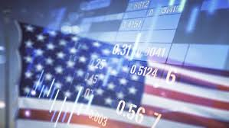
PRESENTATION
AURELIEN LEGENDRE
ANALYZING U.S. MARKET
CONSUMER SPENDING PATTERNS (2010S)

Slide 2
MARKET ANALYSIS
AURELIEN LEGENDRE
THIS PROJECT AIMS TO EXPLORE
HOW U.S. CONSUMER SPENDING EVOLVED DURING THE 2010S.
We will see in the presentation the evolution of the transaction volume and amount during the decade and as well the market segmentation.
To perform the analysis, and due the volume of data +13 million rows on the transaction table, I choosed Jupyter Notebook with the PySpark library.
I used the Extract – Transform – Load process by connecting to the database (kaggle.com which contains millions available cases).
Then during the Exploratory Data Analysis, cleaned and transformed data into the right format to prepare for analysis to focus on the analysis objective.
As the table ‚Merchant Category Codes’ contains 109 unique codes, I grouped some categories to get the proper DataFrame (for technical reason – minimizing server resources, and for analytical reasons – optimizing the readiness)
The next step was the data visualization in order to discover clusters, trends and more.
To do this, I have created line plots, scatter plots, heatmap and a segmentation market table.
The the last step is my conclusion to answer the aim of the analysis.

Slide 3
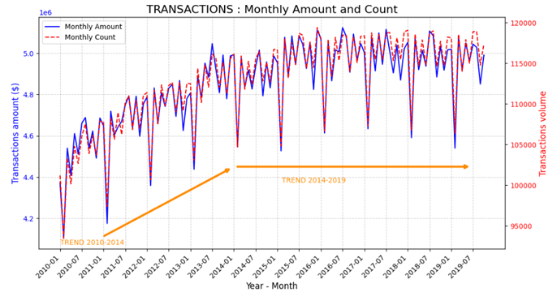
MARKET ANALYSIS
AURELIEN LEGENDRE
TRENDS
Due to a big data volume in the transaction table, i used PySpark, Pandas and Matplotlib libraries for this analysis
Observing the transaction amount exhibits a consistent trend since 2014; I included the transaction volume to confirm whether the change in trend is attributed to inflation.
The amounts and volume of transactions remain consistent, indicating that inflation is not the reason.
Certain elements that might clarify the stabilization include:
Normalization of the monetary policy framework by the FED (Federal Reserve System)
Rise in the key rate since 2015 to dampen investments.
During the 2010/s decade, 2 main trends appears :
Growth period : 2010 - 2014
Stable period : 2014 - 2019

Slide 4
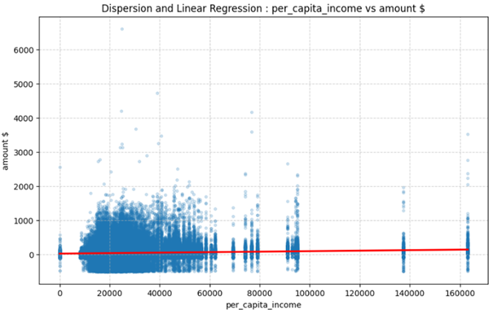
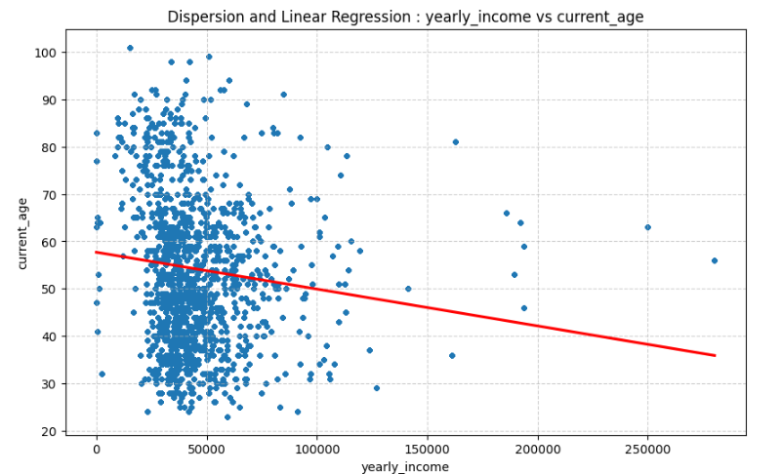
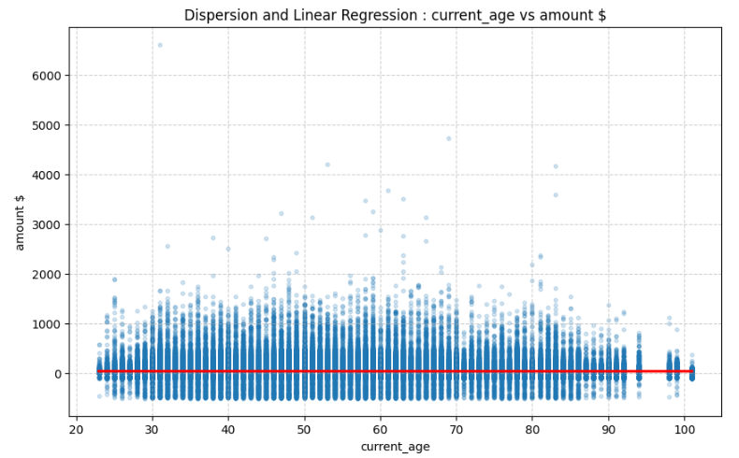
MARKET & SEGMENTATION ANALYSIS
AURELIEN LEGENDRE
CLUSTERS
To discover cluster, i used scatter plots using Pandas and Seaborn libraries.
3 clusters shows a yearly income per person
10K$ to 35K$
35K$ to 55K$
Above 55K$
The graph typically displays an annual income ranging
25K$ to 50K$
50K$ to 75K$
Above 75K$
Globally a transaction amount is up to 1k$

Slide 5
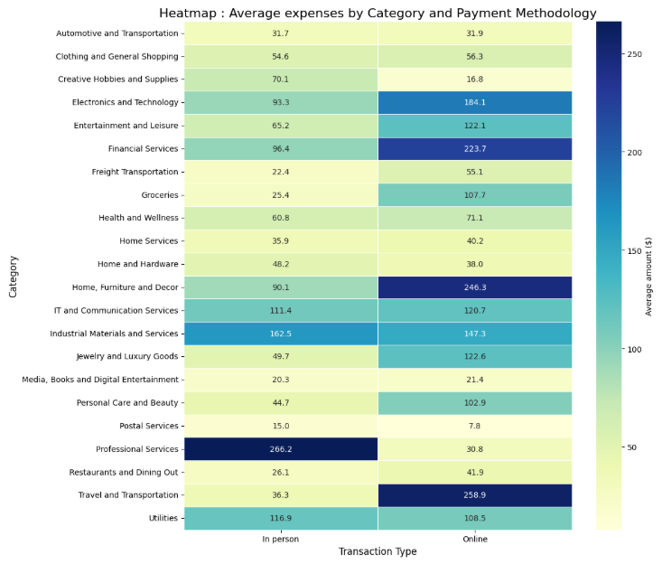
SEGMENTATION ANALYSIS
AURELIEN LEGENDRE
HEATMAP
The heatmap is done using Seaborn library
To verify the market segmentation, I have created a heatmap which shows the Average expenses by Category and split on the methodology payment (In person / On place and Online).
The purpose was to verify if a trend will appear.
Professional Services are paid 'In person'.
For the categories below, transactions are mainly done Online
-> Travel and Transportation
-> Home, Furniture and Decor
-> Financial Services
-> Electronics and Technology

Slide 6
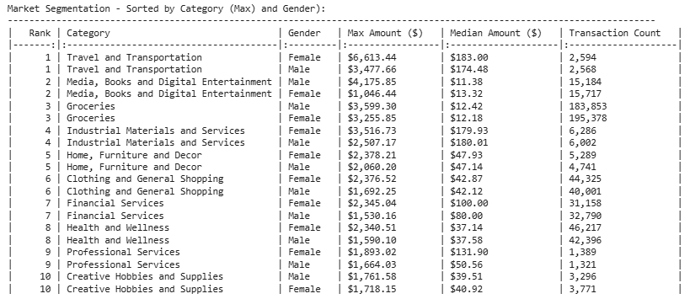
SEGMENTATION ANALYSIS
AURELIEN LEGENDRE
GENDER & AMOUNT SEGMENT
For this data manipulation Pandas was used
Further the previous segmentation, I verified a there are others segments by gender.
High potential categories / business :
Travels : category on which one people can afford to spend the highest
Health / wellness / clothes / shopping : people cares about themself and can afford to spend money on it
Groceries : with the highest volume of transaction.
Overall , there are some distinctions based on gender:
Men : Media, Books, and Digital Entertainment
Women : Home Furniture, Decor, Clothing and Shopping

Slide 7
MARKET ANALYSIS
AURELIEN LEGENDRE
CONCLUSION
HOW DID THE US MARKET EVOLVE DURING THE DECADE OF THE 2010S ?
TREND : 2010 - 2014, the market trend of transaction amount was increasing and from 2014 until 2019, the trend is stable
The standard amount spent for transactions is up to 1000 dollars / 1500 dollars
WHAT ARE THE MARKET SEGMENTS ?
People are able to spend more on travelling and health / wellness / clothes / shopping
Professional Services are paid 'in person' while the categories below are mainly done online:
Travel and Transportation
Home, Furniture and Decor
Financial Services
Electronics and Technology
Groceries is the category with the highest volume of transactions.
Depending on the category and gender, some trends are visibles.
Then I will create an interactive dashboard in Power BI to share this conclusion.
More inquiries arise following the examination:
What has contributed to the stability of the US market trend since 2014?
To address this new question, an alternative analysis can be carried out by examining the annual income progression by client_id to evaluate purchasing

Slide 8

MARKET ANALYSIS
AURELIEN LEGENDRE
THANK YOU

